Slide 1

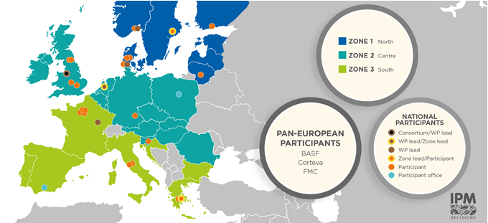

Communication & dissemination strategy
IPM Decisions
Increase the impact of on-farm DSS for IPM
IPM Decisions – Project 817617
www.IPMDecisions.com
Notes:
In July 2021 the networking phase in IPM Decision starts, after launching the platform. We need to have a clear communication and dissemination strategy, this presentation gives the headlines of this strategy. With input of all project partners we will make a ‘working’ document, to be updated every half a year. This presentation also has questions that will be addressed during the zone meetings

Slide 2
Preliminary Data Modeling [1/3]
Objective: find commonalities between farmers regarding their attitude/use of DSS
Approach: clustering data and explaining groupings (unsupervised and supervised machine learning, data modeling)
Data: survey of 149 farmers from 11 countries, 58 attributes (dimensions)
Challenge:
Need to process different data types (nominal, ordinal, numeric)
Small dataset with a relatively high dimension
Missing values
IPM Decisions – Project 817617
www.IPM-Decisions.com TBC
Notes:
IPM Decisions has two main objectives, to increase the use of DSS across Europe. Building an EU wide network will help us to achieve this. The network consists of several stakeholders that can contribute to a wider use of DSS. What are the target groups we identified so far, and what is the best way to engage with them?

Slide 3
Preliminary Data Modeling [2/3]
Preprocessing: feature selection, missing values removal
Non-linear manifold aware dimensionality reduction with UMAP (for visualization and better density based clustering)
Two separate mappings of 58 dimensional data in 3 dimensions (embedding) for the different data types using Uniform Manifold Approximation and Projection
Combine the two embeddings into one 3 dimensional space (intersection and union approach)
Density based clustering of joined embeddings with the HDBSCAN algorithm
Interactive 3D visualisation of data
Explanation and validation of obtained clusters with C4.5 Decision Tree Classifier
IPM Decisions – Project 817617
www.IPM-Decisions.com TBC
Notes:
IPM Decisions has two main objectives, to increase the use of DSS across Europe. Building an EU wide network will help us to achieve this. The network consists of several stakeholders that can contribute to a wider use of DSS. What are the target groups we identified so far, and what is the best way to engage with them?

Slide 4
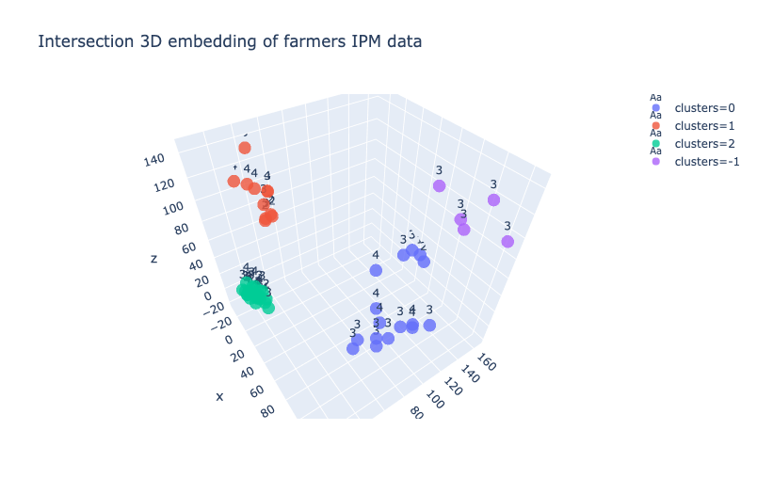
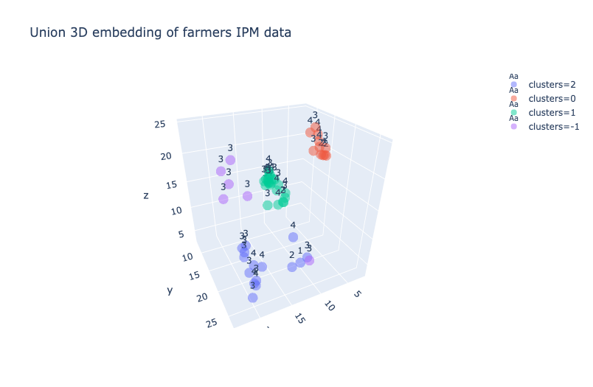
Preliminary Data Modeling [3/3]
Visualisation of clusters and data in 3 dimensions
IPM Decisions – Project 817617
www.IPM-Decisions.com TBC
Notes:
IPM Decisions has two main objectives, to increase the use of DSS across Europe. Building an EU wide network will help us to achieve this. The network consists of several stakeholders that can contribute to a wider use of DSS. What are the target groups we identified so far, and what is the best way to engage with them?

Slide 5
Preliminary Data Modeling [3/3]
Decision tree classification
PA: 71.6418 %
MCC: 0.140
IPM Decisions – Project 817617
www.IPM-Decisions.com TBC
Notes:
IPM Decisions has two main objectives, to increase the use of DSS across Europe. Building an EU wide network will help us to achieve this. The network consists of several stakeholders that can contribute to a wider use of DSS. What are the target groups we identified so far, and what is the best way to engage with them?

